Slide 1
Session 4: Case Studies and Examples
Betty Evangelinou
Senior Project Manager at GRNET
IDCC25 Skills4EOSC Workshop – February 17, 2025, Hague

Slide 2
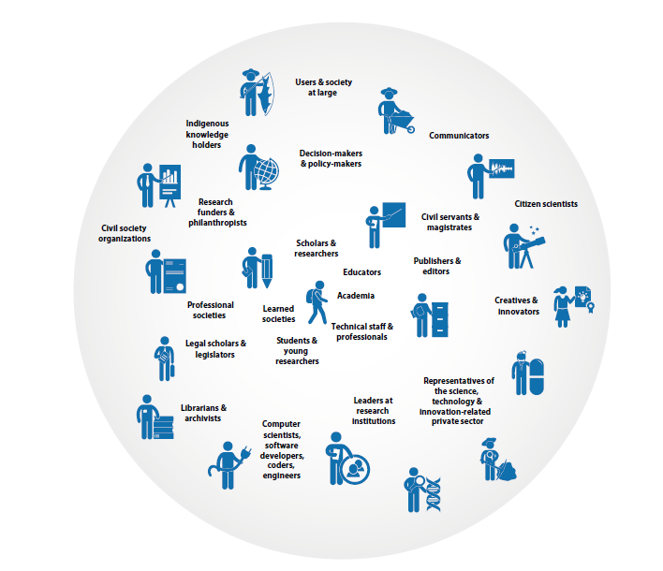

Tailored Training for specific
professional profiles
Why!
Policy Makers
Researchers
Undergraduates
Image: UNESCO - Open Science Outlook 1 https://doi.org/10.54677/GIIC6829
Data Stewards
Legal Experts
Ethics Advisors
Civil Servants
RI Professionals
Masters Students
Honest/Knowledge Brokers

Slide 3
Tailored Training for specific
professional profiles
Why!
Image: UNESCO - Open Science Outlook 1 https://doi.org/10.54677/GIIC6829

Slide 4
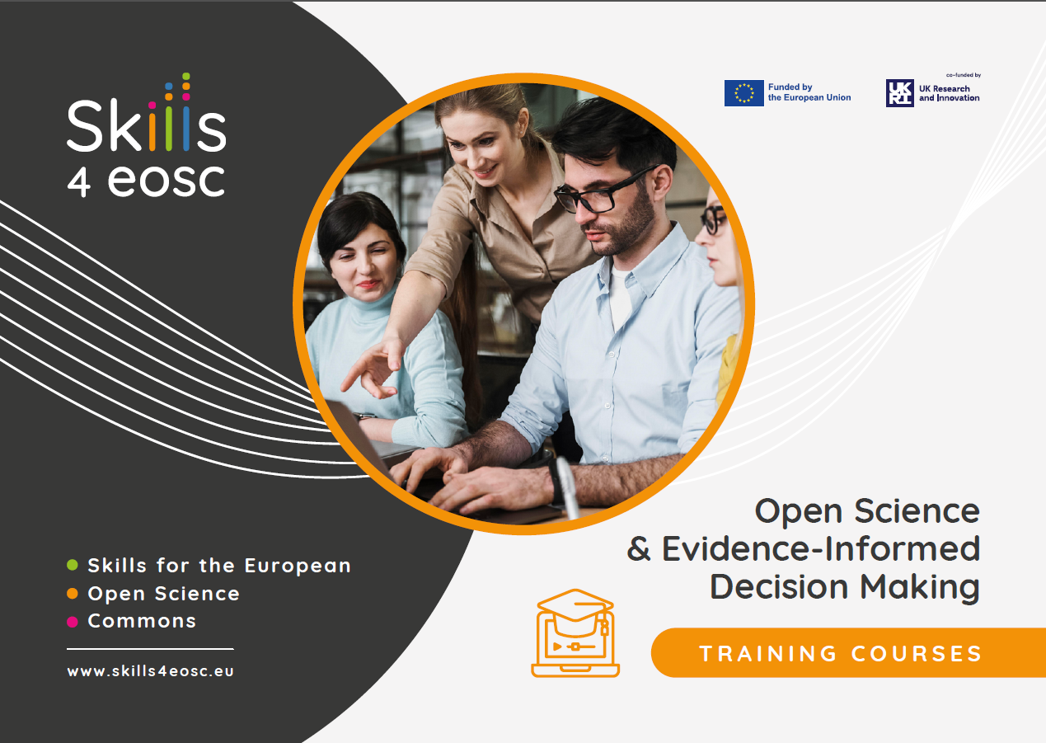
Train of Trainers Course on Open Science and Evidence-Informed Decision Making
What!
Course Audience:
Master Trainers in Skills4EOSC Competence Centers
Trainers in the field of Open Science related to Decision Making
Professionals in the field of Decision Making
Researchers collaborating with Decision Makers
Open Science Advocates
Anyone interested in Open Science and Decision Making

Slide 5
Training Material Preparation Approach Following FAIR-by-design Methodology
How!
Backward Instructional Design Empowered with FAIR principles
focusing on both learners and peer instructors
Prepare
Discover
Design
Produce
Publish
Verify
Deliver
1. Do you understand FAIR and its implications?
2. Define purpose, learning objectives, target audience
1. Find existing resources
2. Identify potential for reuse
attribution
tools & formats
1. Define syllabus and structure
- facilitation materials
- granularity
2. Decide on license
1. Develop content
- compatibility
2. Define metadata
3. Internal QA check
1. Release to public
- for learners & instructors
2. Ensure accessibility
- define attribution
3. Enable feedback gathering
1. Final QA check
2. Add to training catalogue
3. Use gathered feedback for continuous improvement

Slide 6
The experience of developing the training material
How!
Experts from different organisations were included in discussions
Experts with different backgrounds and expertise provided different views on the material
Experts closely collaborating with policy makers provided their views on how to approach the audience and the necessary skills that are needed in the specific professional profiles
Experienced trainers provided their contribution on specific approaches and activities
Science Communicators provided their point of view on the material and the way to organise the necessary skills
Individual discussions and interviews were conducted about the overall training material with people related to policy
Research on necessary skills and competences of the targeted professional profiles
Trial and Error – Pilots performed to gather feedback on the first version of material
Several updates based on feedback, not only for the actual material, but also for the structure of the trainings

Slide 7
MVS for the 3 profiles: Policy Maker
Prepare
Research Policy/Decision Maker Facilitating OS
Evidence-informed Policy and Decision Maker
Associated function titles: Research Policy Maker, Science Policy Facilitator, Strategic Policy Advisor
Associated function titles: Policy Designer, Open Science Data Analyst, Policy Advisor
Essential skills and competences
Essential skills and competences
In-depth understanding of science practice, OS and FAIR principles and practices.
Expertise in establishing appropriate strategies, frameworks and courses of action to foster and enhance OS.
Ability to relate OS practices to the interests of Research Performing Organisations, Funders, and other stakeholders.
Ability to assess the financial sustainability of policy outcomes.
Knowledge about Intellectual property rights and non-personal data management.
Knowledge of the Ethical principles, frameworks and codes of conduct applicable to research.
Knowledge of legal issues related to data governance including data use agreements and personal data regulations.
Basic understanding of OS/ FAIR principles.
Knowledge of OS services, resources and research practices that produce evidence relevant to the decision-making context.
Expertise in applying evidence from OS to the decision-making context, considering the opportunities, limitations, and constraints.
Knowledge management: synthesising outputs of research and consultation, identifying their relevance to specific issues and stakeholders.
Policy evaluation: ability to monitor and evaluate existing policies relevant to the decision-making context, including their implementation and outcomes.
Basic knowledge of research integrity principles, frameworks and ethical codes.
Knowledge of the responsible use of data-driven technologies.

Slide 8
MVS for the 3 profiles: Policy Maker
Prepare
Research Policy/Decision Maker Facilitating OS
Evidence-informed Policy and Decision Maker
Main activities
Main activities
Promotes and supports OS.
Engages all the appropriate target audiences & key stakeholders.
Identifies actions to advance national policies on FAIR and OS.
Understands the importance of addressing gaps in provision of digital skills for FAIR and OS.
Promotes digital skills for data intensive science transferable across different sectors.
Sets up policies or a strategic framework which serve to promote a preferred course of action and could include financial support research.
Identifies available OS outcomes relevant to an issue that requires a policy.
Collaborates with expert communities for elicitation, review and evaluation of data and design of a policy.
Deploys appropriate policy outcome monitoring and evaluation designs based on OS evidence.
Ensures inclusiveness in evidence’s production and evaluation.
Promotes and supports OS as a source of evidence.
Soft/Transversal Skills
Negotiating with stakeholders to articulate rights and responsibilities for policy implementation.
Advocating policy measures by addressing the audiences needed to mobilise key enablers and other human resources.
Mobilising and managing financial and material resources, demonstrating trustworthiness.
Complying with regulations and respecting confidentiality obligations.
Using initiative to formulate policy implementation strategies.
Applying systemic thinking to critically evaluate evidence and its sources.

Slide 9
MVS for the 3 profiles: Civil Servant
Prepare
Civil Servant
Essential skills and competences
Associated function titles: Public Policy Advisor, Government Analyst, Administrative Officer, Policy Coordinator, Regulatory Specialist
Good understanding of OS principles and practices, open data, open research and open access
Developing policies and guidelines that promote OS
Solid understanding of OS research ethics
Being familiar with technology and tools used to support OS practices
Managing projects related to OS
Providing training and education to researchers, policymakers, and public citizens about OS practices
Evaluating the impact of OS practices and make recommendations for future improvement
Good understanding of (personal and non-personal) data management, including data storing, analysis and sharing according to the FAIR and OS principles
Good understanding of the regulatory framework (national, regional and international) concerning intellectual property rights (eg., copyrights and trade secrets) and other non-personal data (eg. research data and data held by Public Sector bodies). As an example, in the regional level, this may include, but not be limited to, the Open Data Directive, the Data Governance Act, and the Directives and Regulations concerning Copyrights and Trade Secrets in the EU.
Main activities
Clarify and shape OS strategy and priorities for the national and international interest
Involve and engage the right stakeholders and partners in making recommendations or decisions on OS
Shape strategies and plans which help put into practice OS (give a long-term direction)
Develop the capabilities in OS of the staff
Engage in the open research process
Ensure compliance with ethical, legal and regulatory criteria
Communicate / actively promote OS
Facilitate the engagement of different stakeholders in co-creation actions
Soft/ transversal skills
Communication, Collaboration, Leadership, Citizen Engagement skills, Negotiation and diplomacy, Innovative thinking, Strategic and analytical skills, Teamwork, Adaptability to changes

Slide 10
MVS for the 3 profiles: Knowledge Broker
Prepare
Knowledge Broker
Essential skills and competences
Associated function titles: Honest Broker, Research Liaison, Information Specialist, Policy Advisor, Evidence Synthesis Expert, Science Communicator, Stakeholder Engagement Coordinator
Being familiar with policy making practices and procedures
Understanding of open, ethical and responsible research principles
Managing considerable amount of information related to OS practices
Searching, retrieving, appraising and synthesizing evidence
Developing and maintaining network of researchers, policymakers, and other stakeholders to help promoting and implementation of OS practices and to support co-creation activities
Providing training and education to researchers, policymakers, and public citizens about OS practices
Evaluating research findings and identify potential conflicts of interest
Tailoring resources to local needs and assessing the context of implementation
Main activities
Bridge the interface between science and policy
Ensure mutual understanding among these parties
Ensure alignment between the needs of the policy community and the evidence synthesis provided
Ensures that the policy community have a good understanding of the implications of the evidence proffered
Ensure the quality and transparency of evidence synthesis
Ensure the evidence synthesis had appropriate expert inputs
Identify options and providing advice from a scientific viewpoint
Identify constraints, uncertainties and caveats
Contextualise the FAIR and OS principles of specific domains
Identify strengths and weaknesses in how OS is applied
Identify needs of change in OS policy or practice in relevant research domains
Ensure all actors are engaged in co-creation actions
Soft/ transversal skills
Communication, Collaboration, Leadership, Self-confidence, Citizens and stakeholders engagement skills, Influencing skills, Mediation skills, Negotiation and diplomacy, Team building and teamwork, Problem-solving skills, Innovative thinking, Analytical and research skills, Adaptability to changes, Networking skills, Interpersonal skills, Stakeholder management and influencing skills, Mentoring skills, Facilitation skills, Change management skills, Improvement skills, IT skills

Slide 11
Key Messages
Prepare
Discover
Design
Open science is essential for advancing research and innovation
Open science is the new normal
Open science is a multi-stakeholder endeavour
Open science leads to more transparency, reproducibility, reliability and accountability
There are challenges to implementing open science, but there are ways to overcome them
Policy plays a critical role in supporting open science
What can Policy Makers do for Open Science to succeed
Policy Makers need to invest in new competencies in Open Science and related professional profiles and careers
There are costs associated with not supporting open science and FAIR management of research outputs
Policy makers/civil servants/knowledge brokers can make use of OS outputs for evidence-based decisions
There are many successful examples on real-life scientific topics with high societal impact of use OS in policy making.
Public organizations should develop strategies for implementing open science policies
Scientists’ engagement is key to effective and equitable evidence-informed decision-making
Ethical, Legal and Societal issues are central to support Open Science.
Open Science-positive policies can become the catalyst for change in reward and hiring practices, as well as responsible research assessment

Slide 12
Challenges and solutions in developing the training courses
Discover
Design
Produce
Challenges | Mitigation Measures/Solutions
No relevant existing courses related to the specific target profiles and Open Science | Identified the main Key Messages and Learning objectives, identified related material and adapted it to the specific target profiles – developed a lot of new material – reused parts of existing material, in new context
A big team of trainers needs to be managed in specific timeframes | Regular structured meetings and additional technical support is necessary, during the implementation of the training material and course structure. Clear guidelines and preparation of supporting material for different development phases is much appreciated from the trainers.
A wide range of material to be developed in order to cover the MVS competences for the 3 profiles | Identified existing expertise in the team of authors/trainers and matched the expertise to specific material/interests.
Existing material could not be reused (copyrights) | Created new material, in different formats based on targeted learning objectives
Additional “Trending Topics” were relevant | Identified the trending topics and the necessary expertise in the pool of trainers/authors
Evaluation/Certification of the acquired knowledge | Create activities and assignments in form of essays and personal experience
Students Engagement during the courses | Live Sessions including Interactive Activities, most usually group activities and interactive polls
Busy Schedules of Students – Difficulties in commitment | Used a Combined learning approach, with both self-paced and short live sessions for each course, to avoid long-day online sessions
Train of trainers Course/Material reusability | Provided different formats of the training material, including video presentations, ppt, pdf version as well as narrative and instructors notes for each presentation. Instructions on how to facilitate each activity are also a big asset.

Slide 13
Pilot Development and Feedback (3 pilots implemented)
Publish
Quality Assurance and Content Validation:
Ensures that course materials, quizzes, and assignments align with the intended learning outcomes.
Helps identify gaps, redundancies, or inconsistencies in the content.
Testing Learning Experience and Engagement:
Assesses whether the course structure, format, and tools are engaging and meet learner expectations.
Identifies whether activities, quizzes, and assignments are at the right difficulty level.
Refining Instructional and Facilitation Approaches:
Helps trainers refine their delivery techniques, ensuring clarity, engagement and time management.
Allows for testing different interactive strategies, such as polls, case discussions, and group activities.
Gathering Participant Feedback for Course Improvement:
Early participants provide valuable insights on course clarity, difficulty, and effectiveness.
Feedback collected through surveys, focus groups, or direct discussions informs necessary adjustments.

Slide 14
Open Science and Evidence-Informed Decision Making Training Course in detail
Verify
Learning Path details:
Training Course 1: “Open Science is the new norm”
Training Course 2: “Ethical, Legal and Societal Implications (ELSI) and Data Governance”
Training Course 3: “Introduction to Evidence-informed Decision-making”
Training Course 4: “Open Science Stakeholders and Collaboration Strategies”
Training Course 5: “Empowering the Future of Research with Open Science”
Training Course 6: “Open science policies support open science practices”
Training Course 7: “Implementing Open Science Policies”

Slide 15



Training Course 1: “Open Science is the new norm”
Module 01:
Fundamentals of Open Science
Lecture 01: Open Science values and principles
Lecture 02: FAIR Principles and their role in Open Science
Lecture 01: Societal and Economic impact of Citizen Science from Galileo to post-truth populism
Module 02:
Open Science and Society
Lecture 02: Societal Impact of Open Science - Real-life examples
Module 03:
Open Science is Essential for Advancing Research and Innovation
Lecture 01: Open Science: Benefits for scientific progress
Lecture 02: Open Science in Practice (optional)

Slide 16
Training Course 1: “Open Science is the new norm”
Lecture 01: Closed Science - A Historical Perspective and Negative Consequences
Lecture 02: Challenges and Ethical Dilemmas in Closed Science
Module 04:
Open Science vs. Closed Science
Lecture 03: The Economic Impact of Closed Science vs Open Science
Lecture 04: Building a Culture of Openness
Module 05: Accountability and Transparency in Open Science
Lecture 01: Fostering Research Integrity and Reproducibility

Slide 17

Training Course 2: “ELSI and Data Governance”
Lecture 01: Overview of the legal regulatory framework on Personal Data, Non-Personal Data and Intellectual Property
Module 06: Legal and Ethical Frameworks and Considerations in Open Science
Lecture 02: Landscaping Ethical Issues in Open Science
Module 07: Open Science under the EU Data Regulatory Framework
Lecture 01: Open Science and Non-personal Data
Lecture 02: Personal Data in Open Science
Additional Reading: Guidelines for Writing a Privacy Policy in Research Projects
Module 08: Data Governance and Legislative Strategies for FAIR Research
Lecture 01: Planning the FAIRification of data
Lecture 02: Identifying practical "how to" tools to go FAIR

Slide 18
Training Course 3: “Introduction to Evidence-informed Decision-making”
Lecture 01: Policy, Evidence and Evidence-Informed Decision Making
Module 09: Open Science and Evidence-informed Decision Making
Lecture 02: Stakeholders involved in Evidence-Informed Decision Making
Additional Reading: Guidelines and Best Practices for Honest Brokers
Module 10: Evidence-informed decision making - outputs and tools
Lecture 01: Open Science Outputs in Decision-Making
Lecture 02: Data Science Algorithms in Practice
Lecture 03: Interpreting Statistics for Insights

Slide 19
Training Course 4: “Open Science Stakeholders and Collaboration Strategies”
Module 11: Open Science and its Stakeholders
Lecture 01: Open Science Stakeholders
Lecture 01: Creating a Collaborative Culture
Lecture 02: Collaboration Impact
Lecture 03: Case studies of successful collaboration on Open Science
Module 12: Collaboration Strategies for Stakeholders
Lecture 04: Role of open science in fostering collaboration among researchers, practitioners, and the public
Lecture 05: Communicating Uncertainty
Lecture 06: Data Visualisation and Storytelling

Slide 20
Training Course 5: “Empowering the Future of Research with Open Science”
Module 13: Investing in Open Science
Lecture 01: The role of funding in promoting Open Science practices
Module 14: Capacity Building and Training Programs in Open Science
Lecture 01: Understanding Capacity Building in Open Science
Lecture 02: Institutional Support for Capacity Building – Challenges and Best Practices
Lecture 01: Introduction to AI
Module 15: Open Science and Artificial Intelligence
Lecture 02: AI and Open Science
Lecture 03: AI in evidence-informed decision making

Slide 21
Training Course 6: “Open science policies support open science practices”
Module 16:
Open Science Policies
Lecture 01: Introduction to Open Science Policies
Lecture 01: Open Science Policies support Open Science Practices: Stakeholders
Lecture 02: Open Science policies support Open Science Practices: Impact
Lecture 03: Challenges of Implementing and Barriers to adopting Open Science
Module 17: Open Science Policies support Open Science Practices
Lecture 04: Cultural Changes required for Open Science Adoption
Lecture 05: Responsible Research Assessment Movement
Lecture 06: Open Science Infrastructures

Slide 22
Training Course 7: “Implementing Open Science Policies”
Module 18: Implementing Open Science Policies
Lecture 01: Open Science Workflows
Module 19: From developing to evaluating Open Science policies
Lecture 01: Designing Open Science policies in practice
Module 20: Open Science Policies Adaptation
Lecture 01: Adapt policies based on new evidence and changing circumstances

Slide 23
The importance of Training Evaluation: Activities and Quizzes
Quizzes:
Help learners recall information from the presentations
Quick self-evaluated exercises (multiple choice, polls, T/F, etc) – ideal for self-paced learning
Help gauge how well learners grasp key concepts from the course.
Help learners recognize what they know and what they need to review.
Activities/Assignments:
Promote critical thinking – require learners to analyse, synthesize and evaluate information
Allow learners apply concepts to real-world scenarios and develop practical skills
Encourage learners to reflect on what they have learned.
Group activities enhance communication, collaboration, and inclusion
Allow personalised and contextual learning

Slide 24
Individual Assignments and Group Activities
Exploring the Impact of Open Science
Main Goal: Communicate the real-world benefits of Open Science
Type: Reflection Exercise (Self-paced)
Short Description: Participants select and analyze examples from the course, then craft a narrative to convey their impact to a target audience.
Case Study on Ethical Dilemmas in Closed Science
Main Goal: Analyze ethical challenges in closed science
Type: Case Study (Self-paced)
Short Description: Participants examine real-world cases where lack of transparency led to ethical concerns and discuss possible solutions.
I, AI - Ethical Debates and Policy Decisions for the EU In the light of the Development of Conscious AI
Main Goal: Debate policy solutions for emerging AI challenges
Type: Scenario-Based Group Discussion (Live session)
Short Description: Participants engage in a futuristic scenario to assess the implications of conscious AI, discuss regulation, and propose strategies at the EU level.

Slide 25
Individual Assignments and Group Activities
Exploring the Role of Honest Brokers in Real-Life Decision Making
Main Goal: Examine the challenges faced by honest brokers in science-policy interactions.
Type: Case Study & Reflection Exercise (Self-paced)
Short Description: Participants study a real-world case on knowledge brokerage in environmental decision-making, reflect on key challenges, and reflect on how Open Science could improve the process.
Main Goal: Explore the challenges faced by Honest Brokers in science-policy mediation and identify strategies to address them.
Type: Group Discussion & Reflection (Live session)
Short Description: Participants discuss in groups challenges like time constraints, consensus-building, and trust, then reflect on challenges and strategies.
Reflecting on Key Challenges of Honest Brokers
Main Goal: Learn basic data analysis techniques to understand and predict outcomes in real-world scenarios.
Type: Hands-on Data Exploration (Live session)
Short Description: Participants work with a sample dataset to explore trends, find connections between data, and make predictions using simple statistical methods.
Open Data Science Tutorial

Slide 26
Individual Assignments and Group Activities
Organise a "Coffee with Open Science" Session
Main Goal: Develop skills in stakeholder identification and policy discussion facilitation in Open Science.
Type: Scenario Planning & Reflection (Live session)
Short Description: Participants organize a "Coffee with Open Science" session in groups, by selecting a relevant topic, identifying key stakeholders, and justifying their participation in policy discussions.
Main Goal: Practice crafting effective messages for policymakers.
Type: Scenario-Based Communication Exercise (Self-paced)
Short Description: Participants select a policymaking scenario, develop a key message for the target group, and apply communication strategies to engage policymakers effectively.
Guidelines for communication with policy makers
Main Goal: Develop skills to communicate research uncertainty effectively to different audiences.
Type: Roleplay Exercise & Reflection (Self-paced, Live)
Short Description: Participants take on different stakeholder roles to practice verbal communication strategies for conveying research uncertainty.
Focus on… Verbal communication of uncertainty in practice

Slide 27
Individual Assignments and Group Activities
Main Goal: Strengthen advocacy and communication skills by crafting arguments to promote Open Science to funders.
Type: Collaborative Role Play & Reflection (Self-paced, Live)
Short Description: Participants learn to identify funder priorities and craft compelling arguments for Open Science, with a live role-play session where groups pitch to different types of funders.
Advocating for Open Science
Sharing Best Practices and Challenges in Open Science Capacity Building
Main Goal: Reflect on Open Science capacity-building initiatives and identifying transferable strategies and challenges.
Type: Reflection Exercise on personal experiences (Self-paced)
Short Description: Participants will share examples of Open Science capacity-building initiatives from their own contexts, analyze outcomes, and identify strategies for improvement and scaling up initiatives.

Slide 28
Individual Assignments and Group Activities
Analysing an Open Science Policy
Main Goal: Develop the ability to critically analyse Open Science policies, and assess their strengths and weaknesses. Type: Reflective Analysis (Self-paced)
Short Description: Participants select and analyse an Open Science policy, comparing it against a reference document on key Open Science elements.
Main Goal: Analyze real-world Open Science policy case studies to identify stakeholders, key topics, and implementation challenges.
Type: Reflective Analysis & Collaborative Discussion (Self-paced, Live)
Short Description: Participants select and reflect on a case study of Open Science policy, then engage in group discussions to analyze stakeholders, topics, and implementation challenges.
Case studies of Open Science policy development and implementation
Main Goal: Identify and propose solutions to barriers hindering Open Science practices.
Type: Reflection & Collaborative Discussion (Self-paced, Live)
Short Description: Participants explore barriers to Open Science in areas like competitive advantage, publication, and data reuse, proposing solutions.
Barriers to Open Research

Slide 29
Individual Assignments and Group Activities
Main Goal: Design Open Science workflows to explore the integration of Open Science practices in varying research scenarios.
Type: Reflection & Design Exercise (Self-paced)
Short Description: Participants design three research workflows (ideal, difficult, and easy) incorporating Open Science practices across seven research steps, followed by a reflection on their choices and implementation feasibility.
Designing an Open Science Workflow
Main Goal: Critically evaluate Key Performance Indicators (KPIs) to understand their practical relevance and impact in Open Science.
Type: Reflection (Self-paced)
Short Description: Participants review examples of KPIs in Open Science, reflect on the most significant and feasible ones, and discuss how to measure their effectiveness in real-world contexts.
Evaluating Key Performance Indicators (KPIs) in Open Science

Slide 30
Final Courses format and tools
Verify
The final set of courses in the Open Science and Evidence-Informed Decision-Making curriculum follows a structured approach that combines self-paced learning with interactive live sessions to ensure an engaging and comprehensive learning experience.
Self-Paced Component
Delivered through Moodle, allowing learners to progress at their own pace.
Includes pre-recorded lectures, readings, and interactive activities (e.g., quizzes, case studies).
Different formats of material were provided (Video presentations with voiceover, PPTs to facilitate reuse, PDFs to facilitate navigation and sharing, Instructor’s notes and narrative for easier understanding of the narrated video)
Participants complete knowledge checks before moving to the live session.
Live Interactive Sessions
Conducted online via platforms such as BigBlueButton integrated into Moodle.
Features recaps, interactive discussions, and Q&A to clarify concepts from the self-paced section.
Uses Wooclap for icebreakers and interactive polling to engage participants.
Includes group activities, case discussions, and role-playing for practical application.

Slide 31
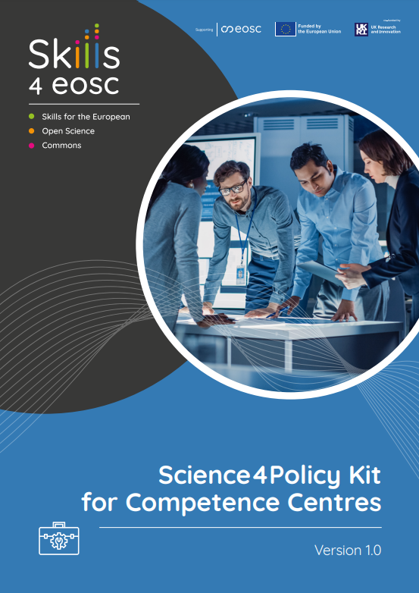
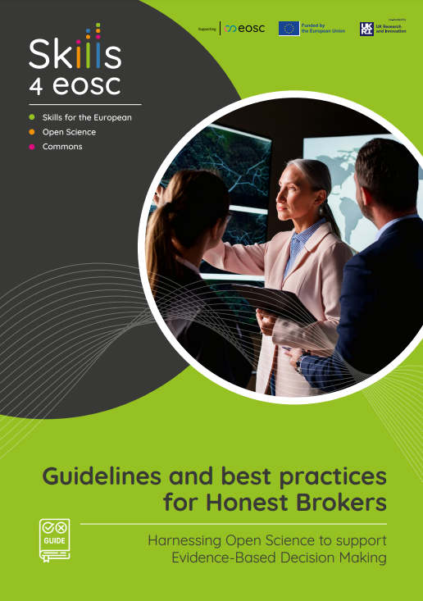
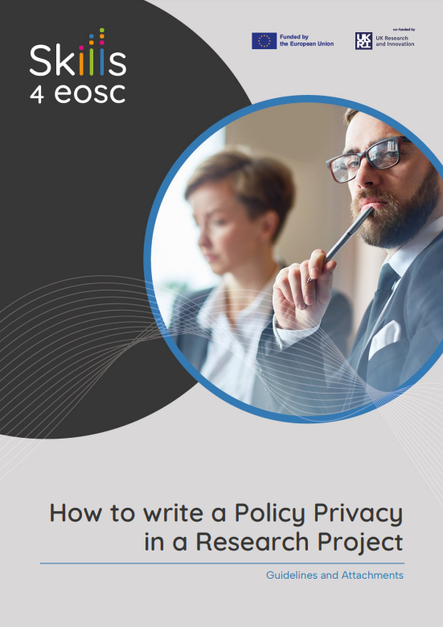
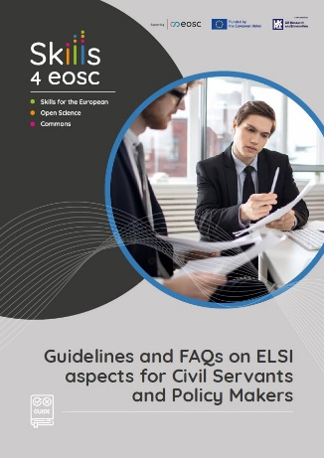
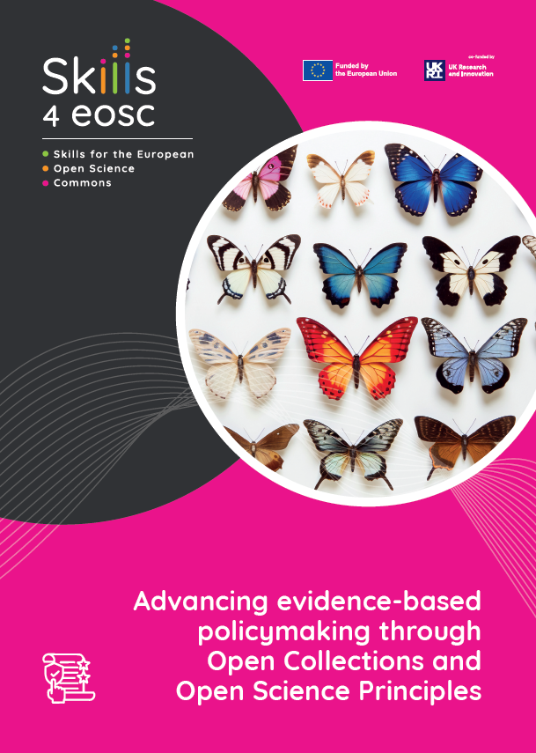
Other relevant material developed within the course
Booklets:
“Guidelines & Best practices for Honest Brokers” Link: https://zenodo.org/records/14712238
“Science4Policy kit for Competence Centers” Link: https://zenodo.org/records/14751412
“Guidelines for Writing a Privacy Policy in Research Projects”
“Advancing evidence-based policymaking through Open Collections and Open Science Principles” Link: https://www.nhm.at/en/publications/978-3-903096-78-3
“Guidelines and FAQs on ELSI aspects for Civil Servants and Policy Makers” (booklet in progress - Full deliverable here: https://zenodo.org/records/14797142)
Workshops:
Science4Policy - Bridging the gap between research and decision-making

Slide 32
Thank you! Questions?
Betty Evangelinou
bevangelinou@admin.grnet.gr
Vector Images Designed by freepik.com

